Slide 1
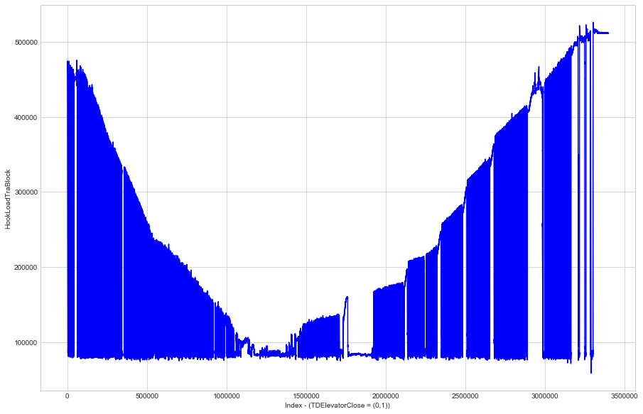
Identify Iceberg Drilling Sequence
Top Drive: Open (0) /Close (1)
Elevator Position:
- Higher: Weight;
- Lower: No weight
Drilling Sequence:
- No weight (0)
- Weight (1)

Slide 2
My Algorithm Result
Red curve (Input): HookLoadTraBlock;
Blue line (Output):
- Top Drive Close = 1 (In drilling process);
- Top Drive Close = 0 (Not in drilling process);
Accuracy:
- Without my algorithm: 60%
- With my algorithm: 99%!

Slide 3
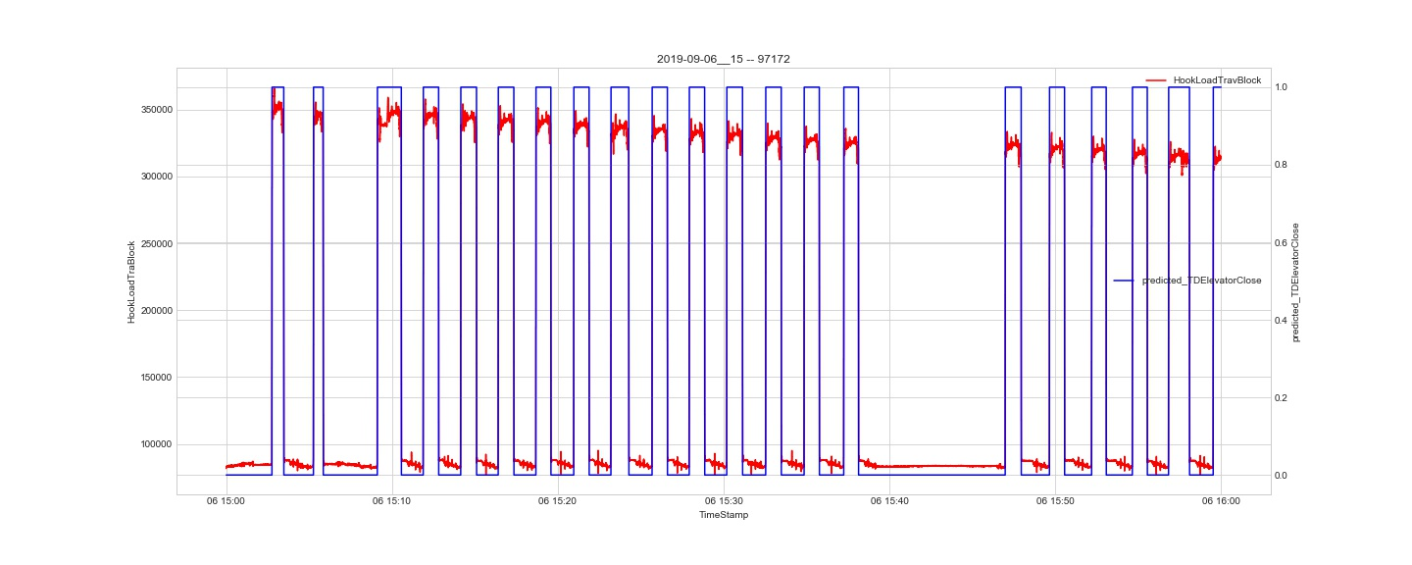
Result

Slide 4
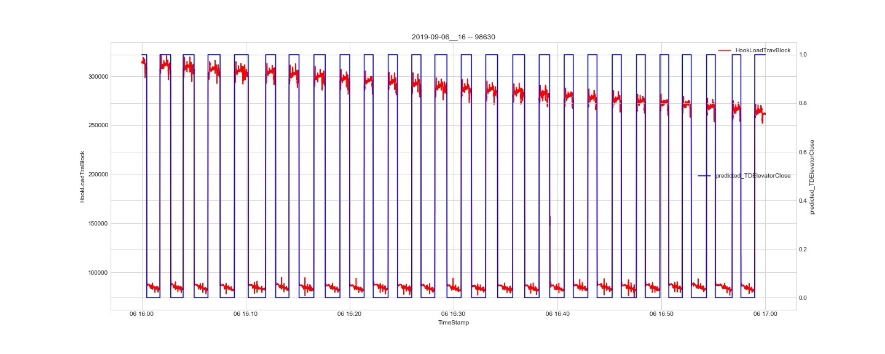
Result

Slide 5
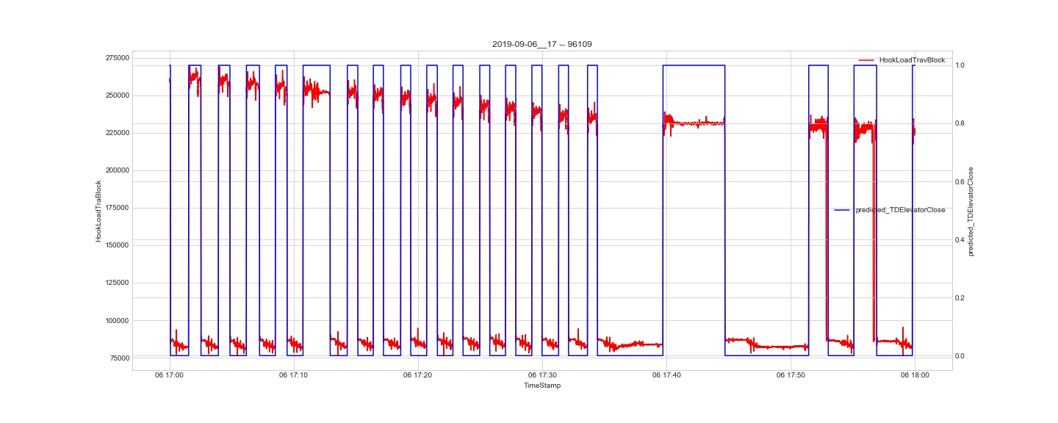
Result

Slide 6
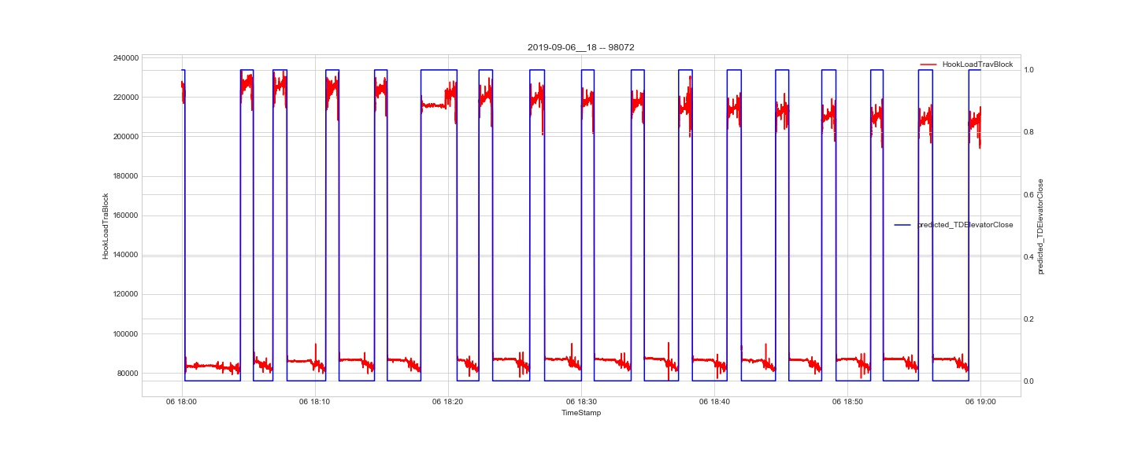
Result

Slide 7
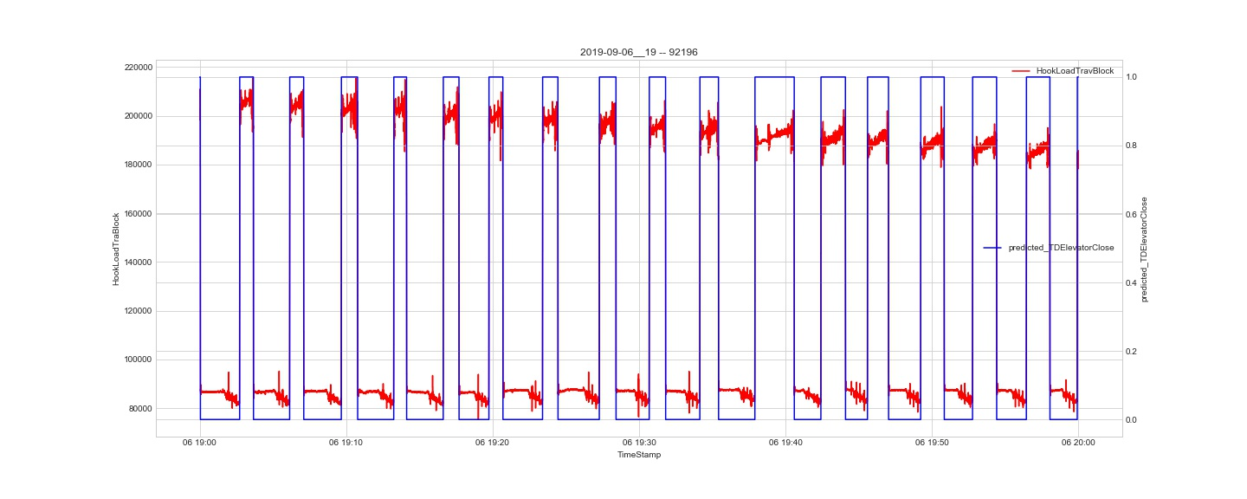
Result

Slide 8
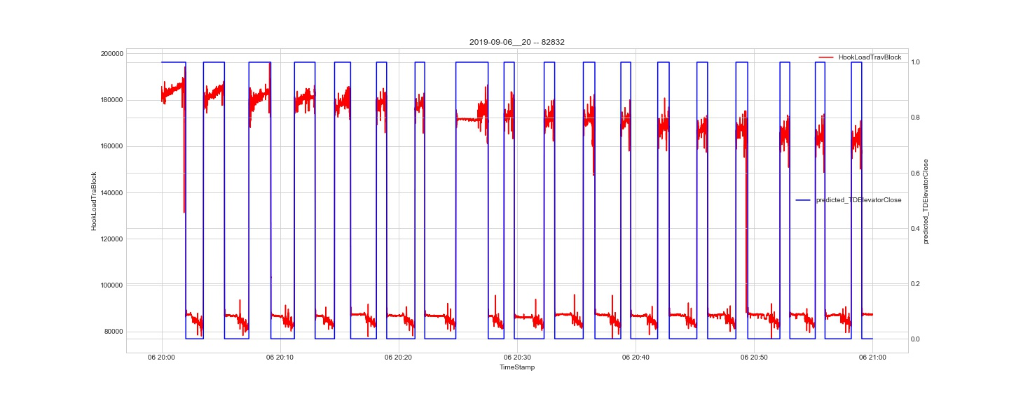
Result

Slide 9
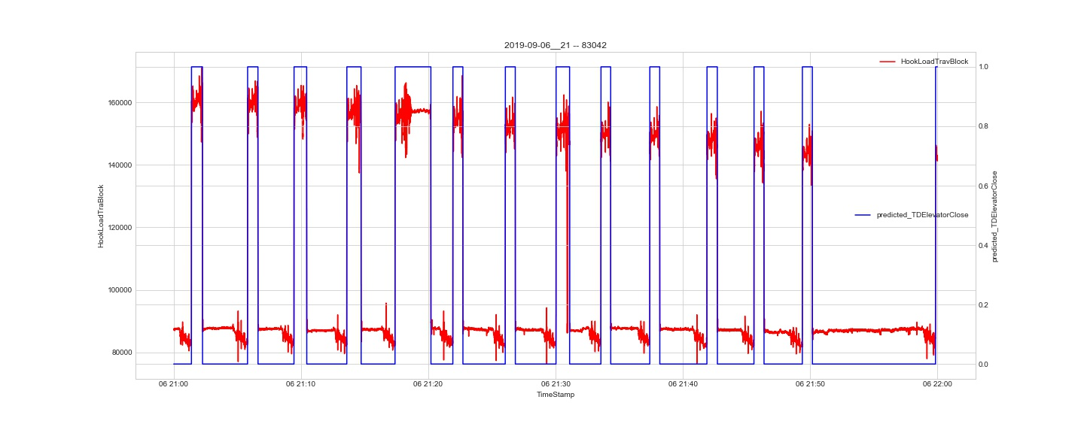
Result

Slide 10
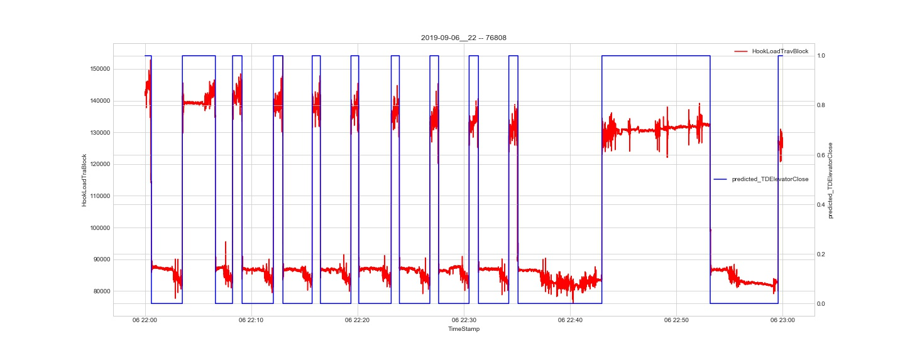
Result

Slide 11
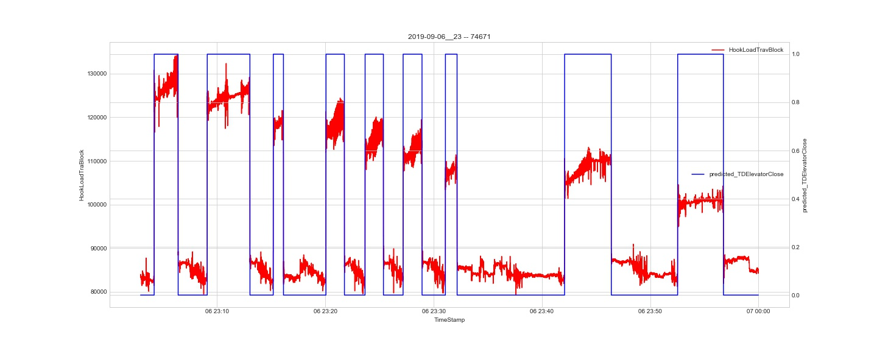
Result

Slide 12
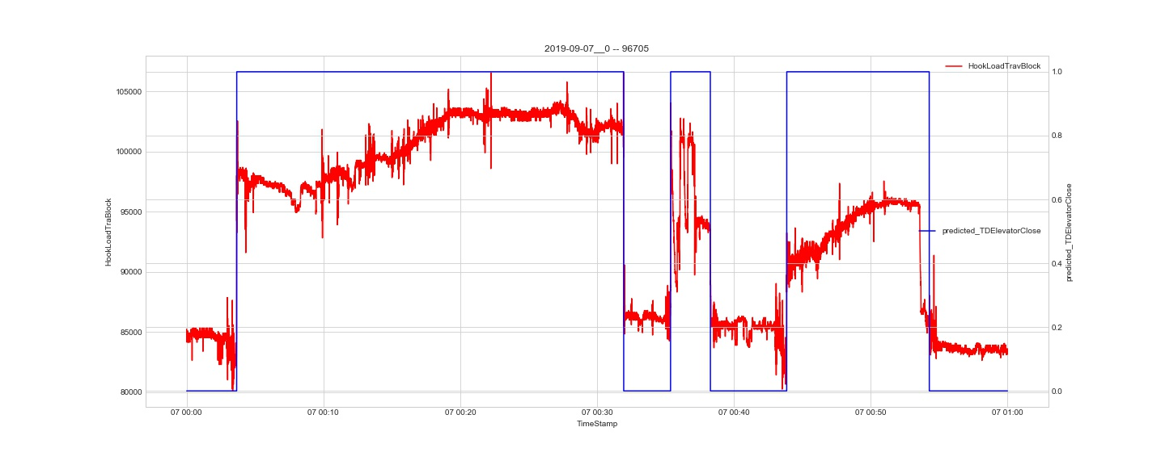
Result

Slide 13
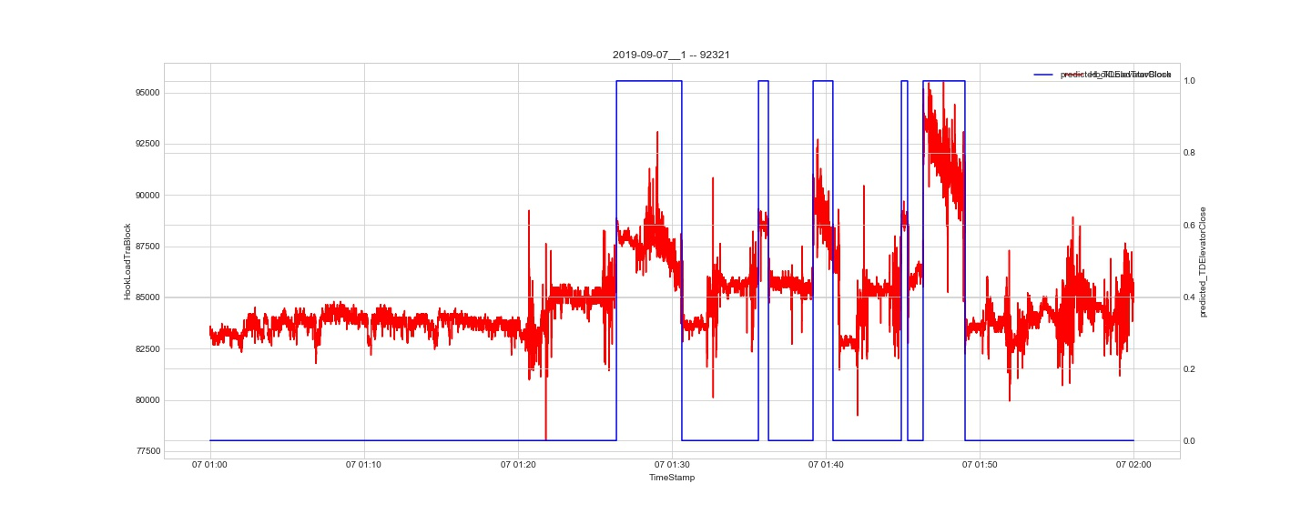
Result

Slide 14
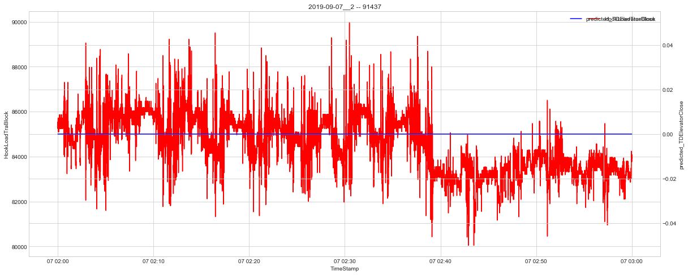
Result

Slide 15
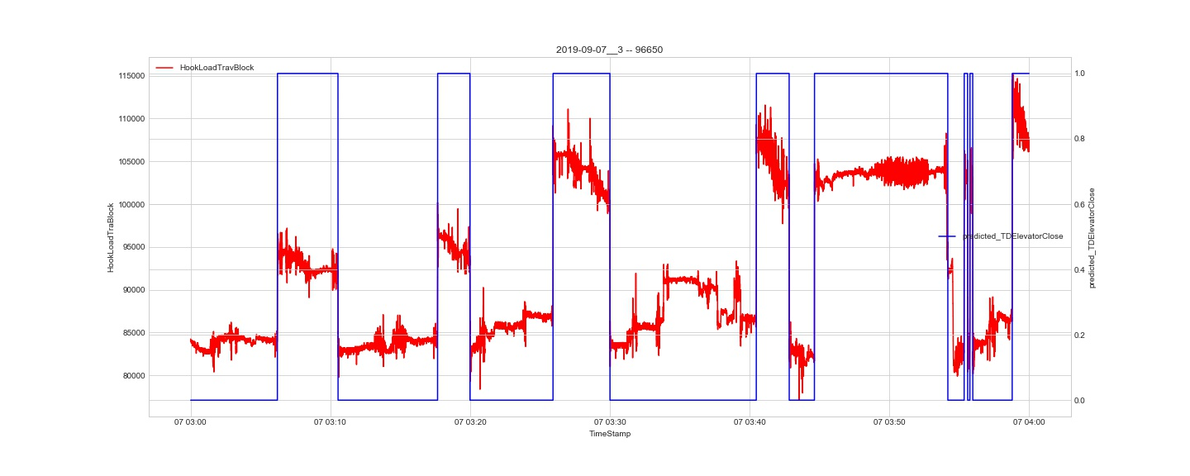
Result

Slide 16
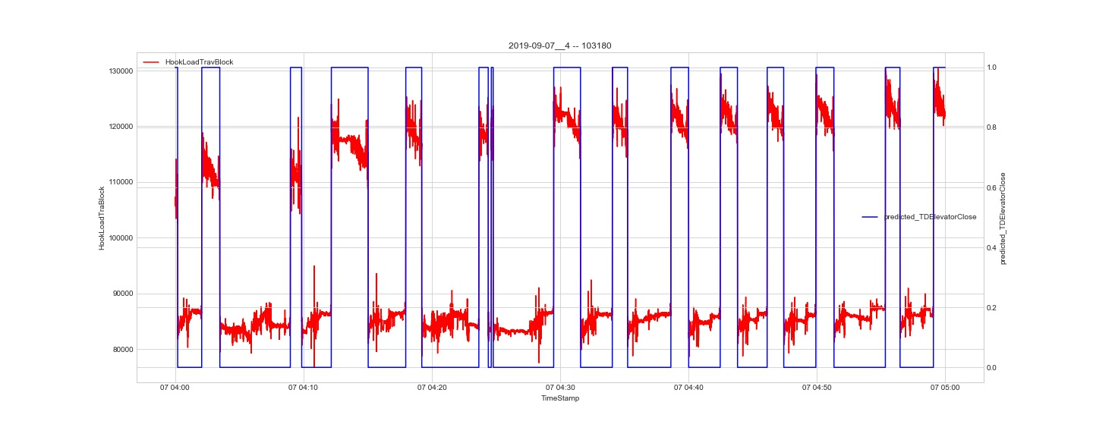
Result

Slide 17
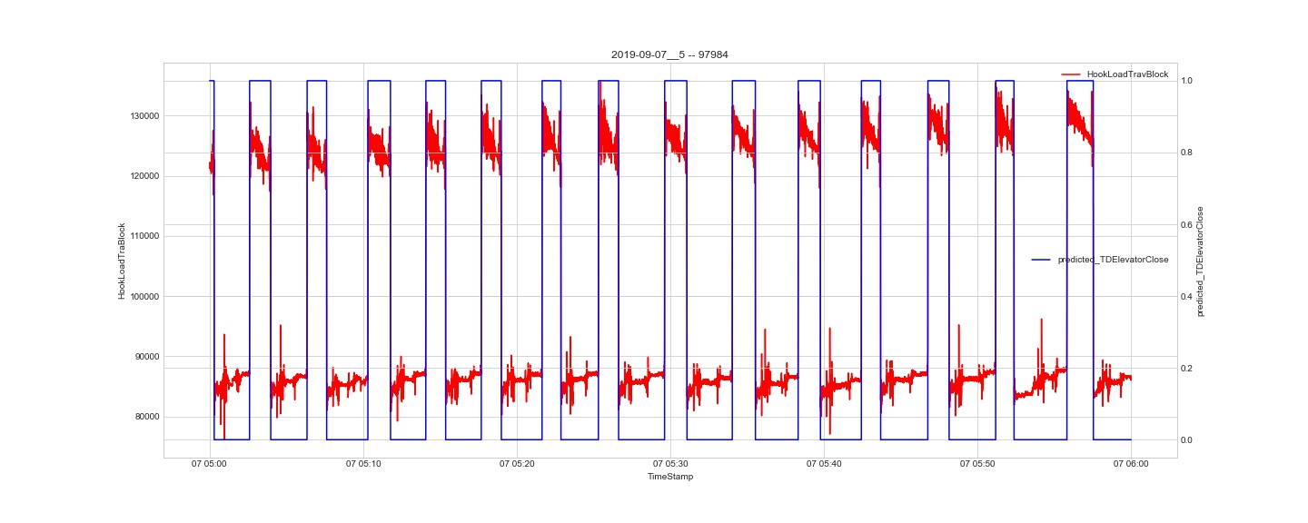
Result

Slide 18
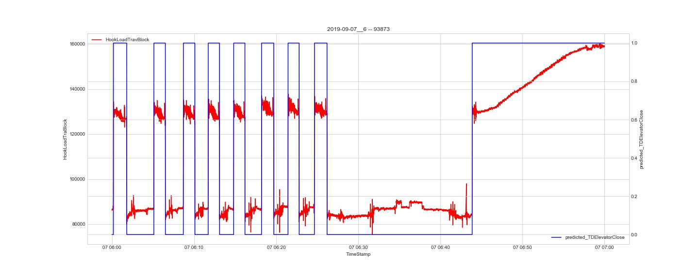
Result

Slide 19
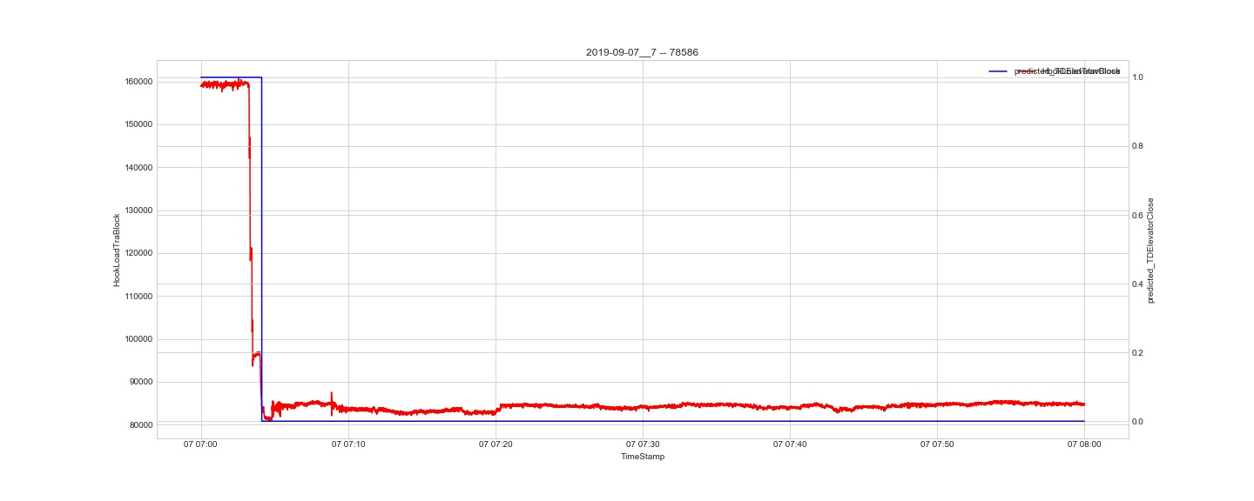
Result

Slide 20
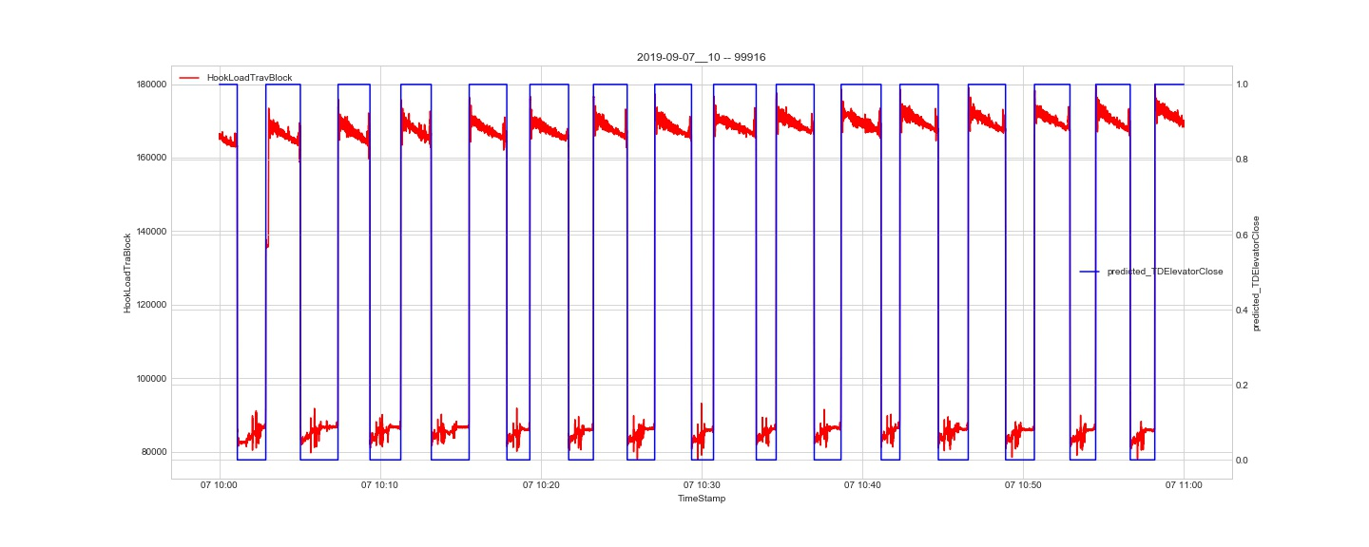
Result

Slide 21
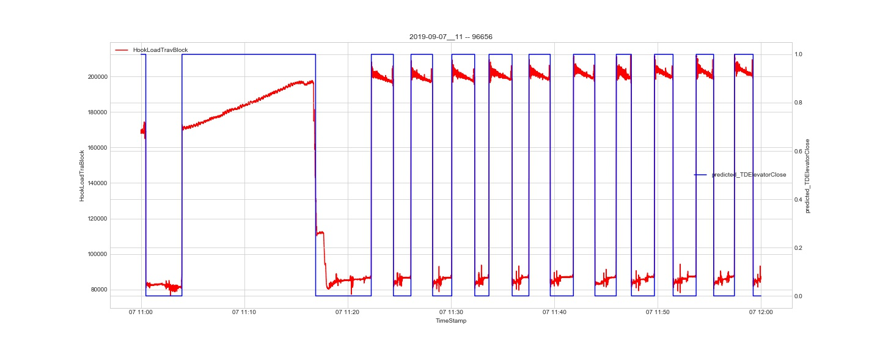
Result

Slide 22
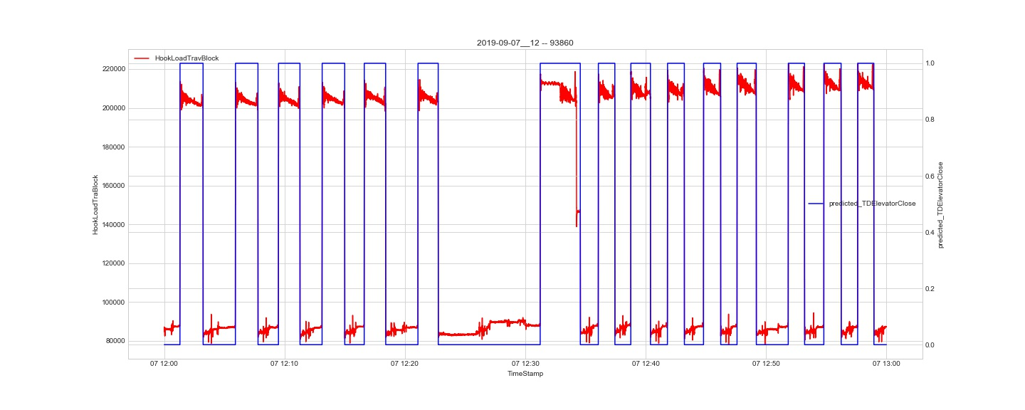
Result

